Slide 1
“Structural timbre”
Characteristic Effect for Proximal Narrow-band Digital Stochastic Noises
ISTD-07 (MM-5)
Koji Sato, Ken Ito, Akinori Takei and Toru Toyoda, Division of Composition and Conducting, Interfaculty Initiative in Information Studies, The University of Tokyo

Slide 2
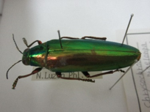
Structural Colour
Jewel Beatle

Slide 3
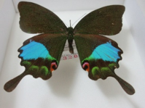
Structural Colour
Morphoes

Slide 4
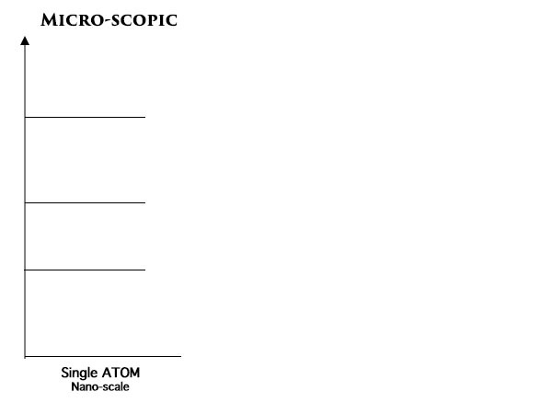
Flame Coloration

Slide 5
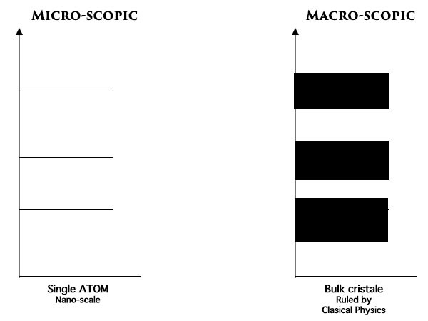
Specular

Slide 6
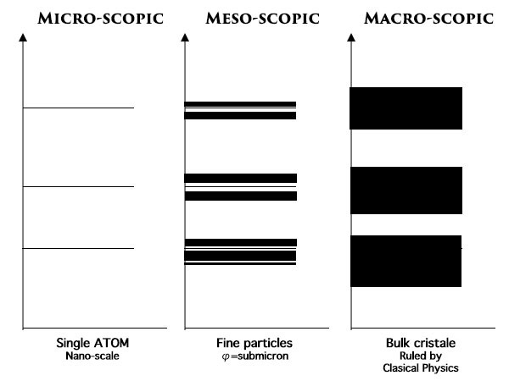
Structural Colour

Slide 7
Morphoes
http://blogs.yahoo.co.jp/kozoshoku/46003474.html

Slide 8
Micro Structure of Morphoes
http://blogs.yahoo.co.jp/kozoshoku/46003474.html

Slide 9
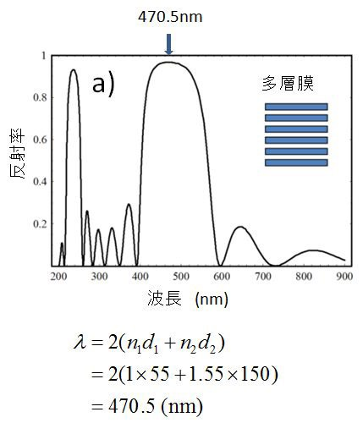
Disperse Colour of Morphoes
Layers
Reflecting Ratio
Wavelength (nm)
http://blogs.yahoo.co.jp/kozoshoku/46003474.html

Slide 10

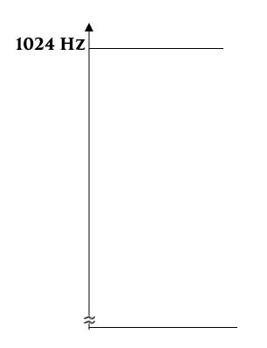
Structural Timbre
Sine Wave for 1024Hz

Slide 11
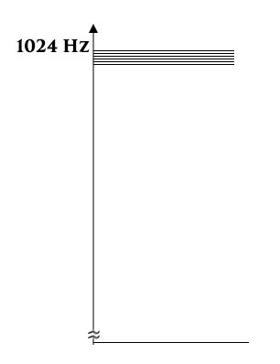
Structural Timbre
Narrow-band Noise b/w 1023 ~ 1024Hz

Slide 12
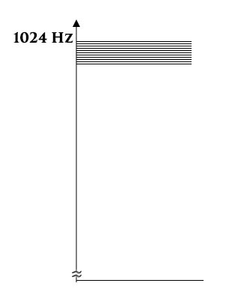
Structural Timbre
Narrow-band Noise b/w 1022 ~ 1024Hz

Slide 13
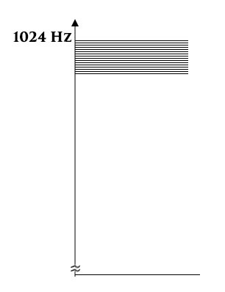
Structural Timbre
Narrow-band Noise b/w 1021 ~ 1024Hz

Slide 14
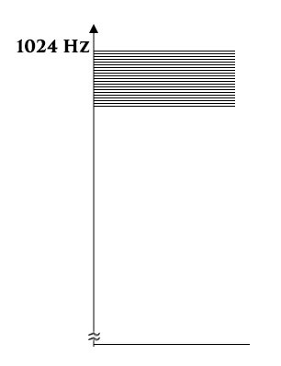
Structural Timbre
Narrow-band Noise b/w 1020 ~ 1024Hz

Slide 15
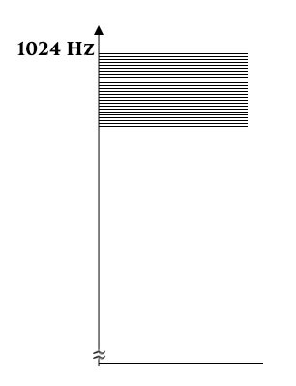
Structural Timbre
Narrow-band Noise b/w 1019 ~ 1024Hz

Slide 16
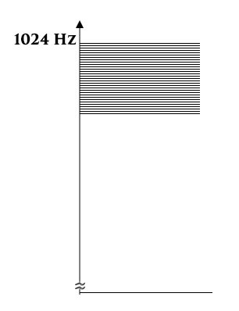
Structural Timbre
Narrow-band Noise b/w 1018 ~ 1024Hz

Slide 17
Structural Timbre
Narrow-band Noise b/w 1017 ~ 1024Hz

Slide 18
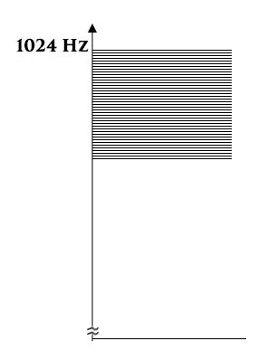
Structural Timbre
Narrow-band Noise b/w 1016 ~ 1024Hz

Slide 19
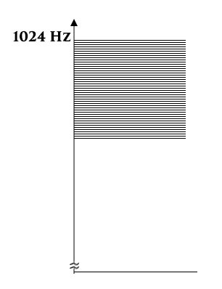
Structural Timbre
Narrow-band Noise b/w 1015 ~ 1024Hz

Slide 20
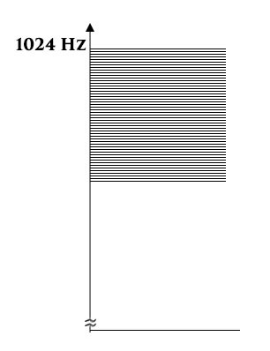
Structural Timbre
Narrow-band Noise b/w 1014 ~ 1024Hz

Slide 21
Structural Timbre
Sine Wave for 1024Hz

Slide 22
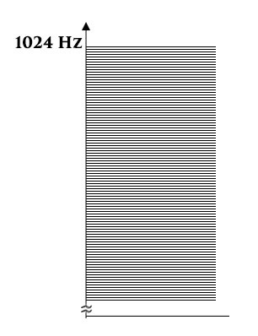
Structural Timbre
Narrow-band Noise b/w 992 ~ 1024Hz
(Quarter Tone Bandwidth)

Slide 23
Structural Timbre

Slide 24
Structural Timbre

Slide 25
Structural Timbre
Fluctuate

Slide 26
Structural Timbre
Fluctuate
Dispersed

Slide 27
Structural Timbre
Fluctuate
Dispersed
Blurred

Slide 28
Structural Timbre
Fluctuate
Dispersed
Blurred
Interfering

Slide 29
Structural Timbre
Fluctuate
Dispersed
Blurred
Interfering
⇒ Brilliant

Slide 30
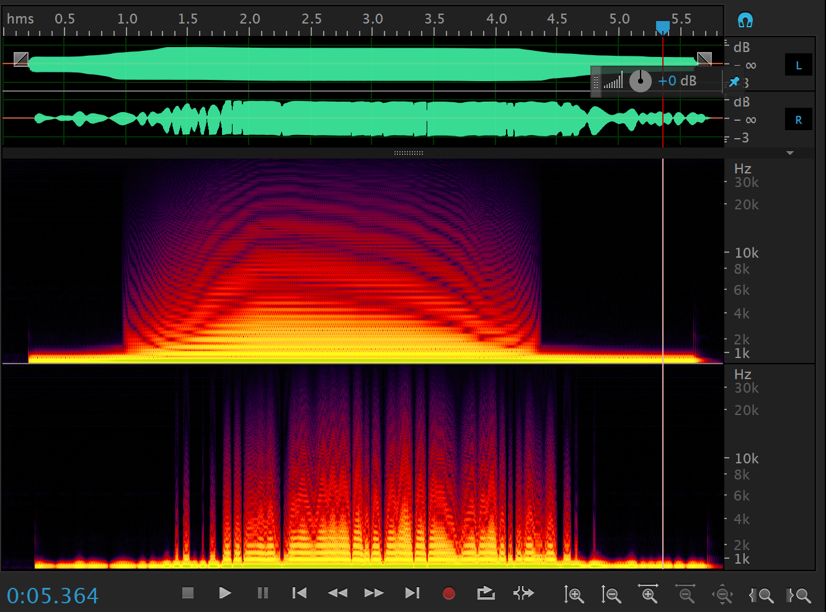
Structural Timbre
Fluctuate
Dispersed
Sine Wave 256Hz
Blurred
Noise b/w 240 & 256Hz
Interfering
⇒ Brilliant

Slide 31
How to generate Super Narrow-band Stochastic Noises

Slide 32
Basic Workflow for Super Narrow-band
Stochastic Noises
Generating White Noise
Super Narrow Band Pass Filter
Sum The Obtained Spikes

Slide 33
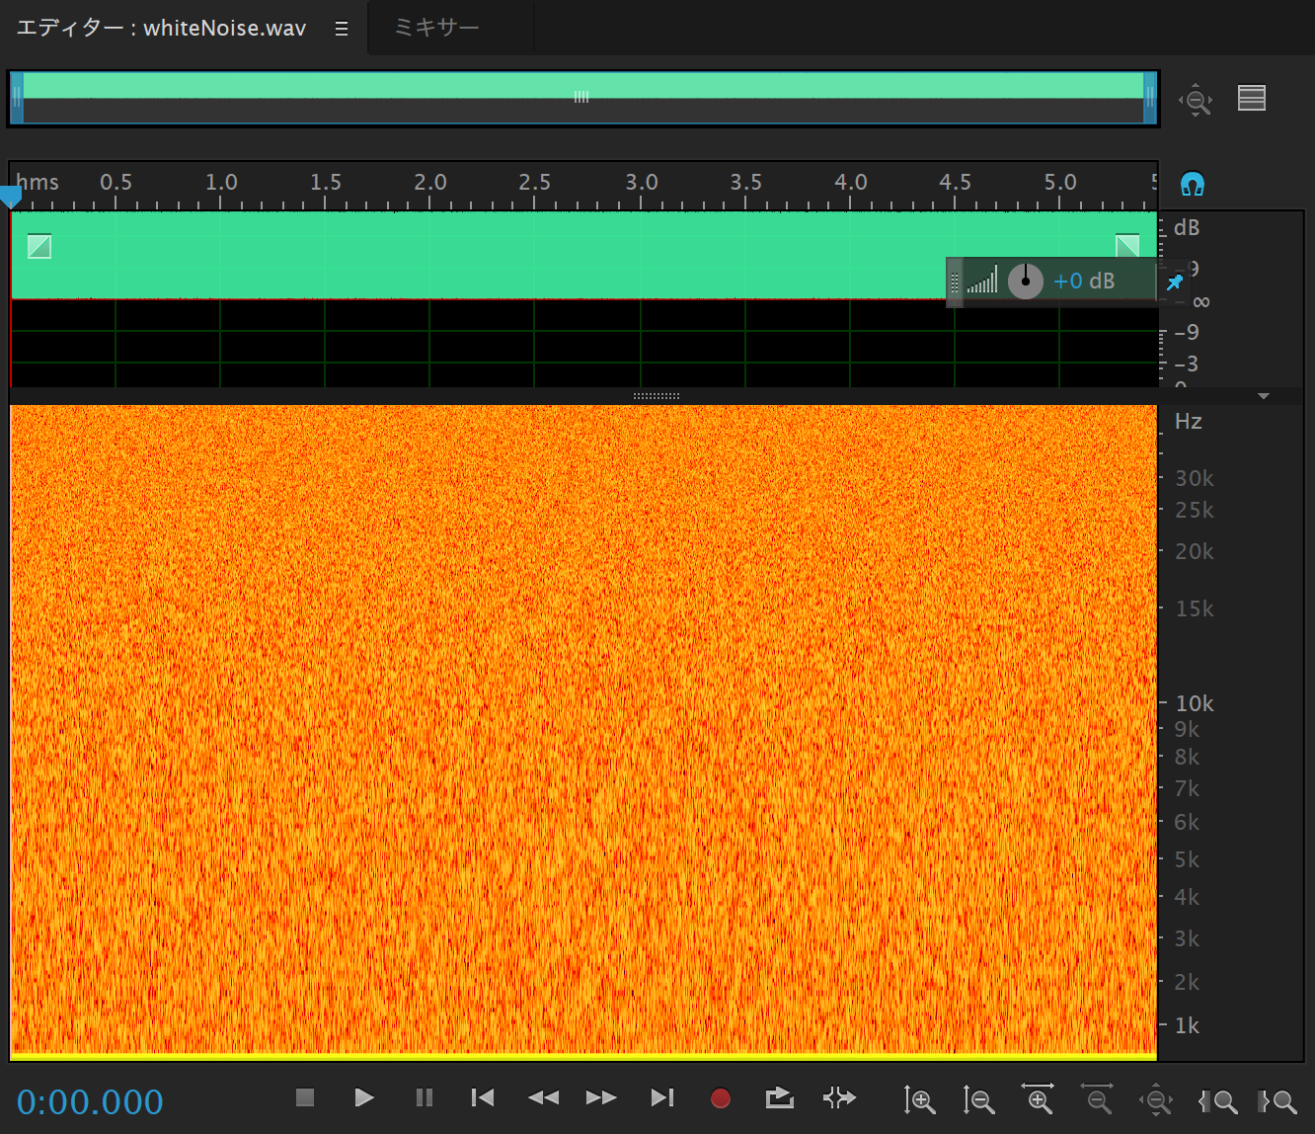
Generating White Noise
Using rand() in MATLAB

Slide 34
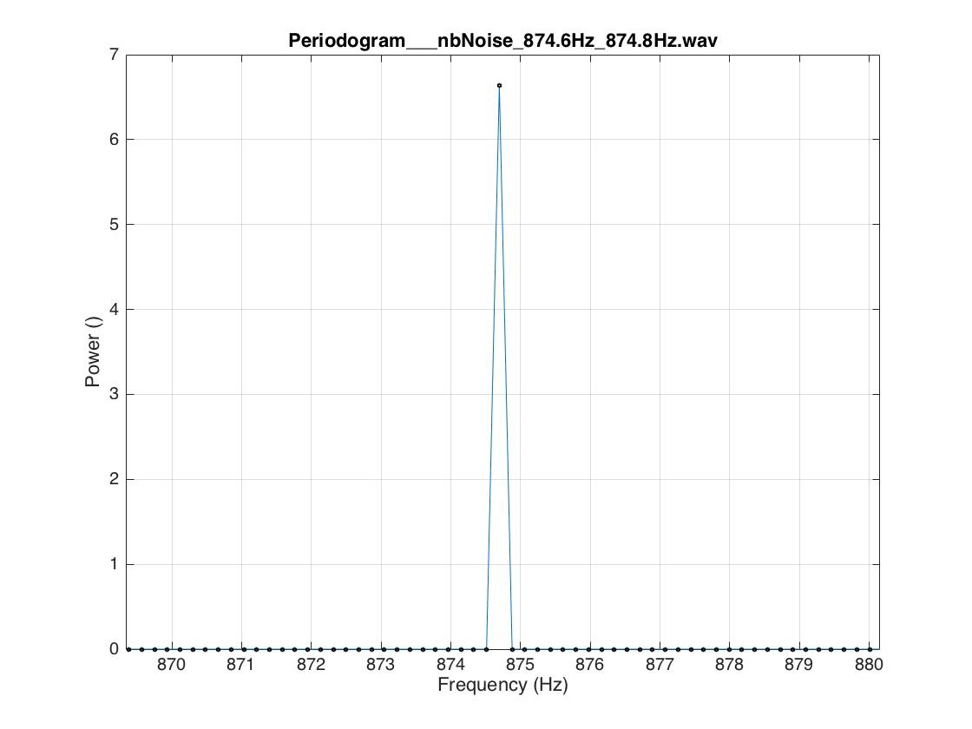
Super Narrow Band Pass Filter
BandPass Filter through FFT
by Irino, T. (2006) (customised)

Slide 35
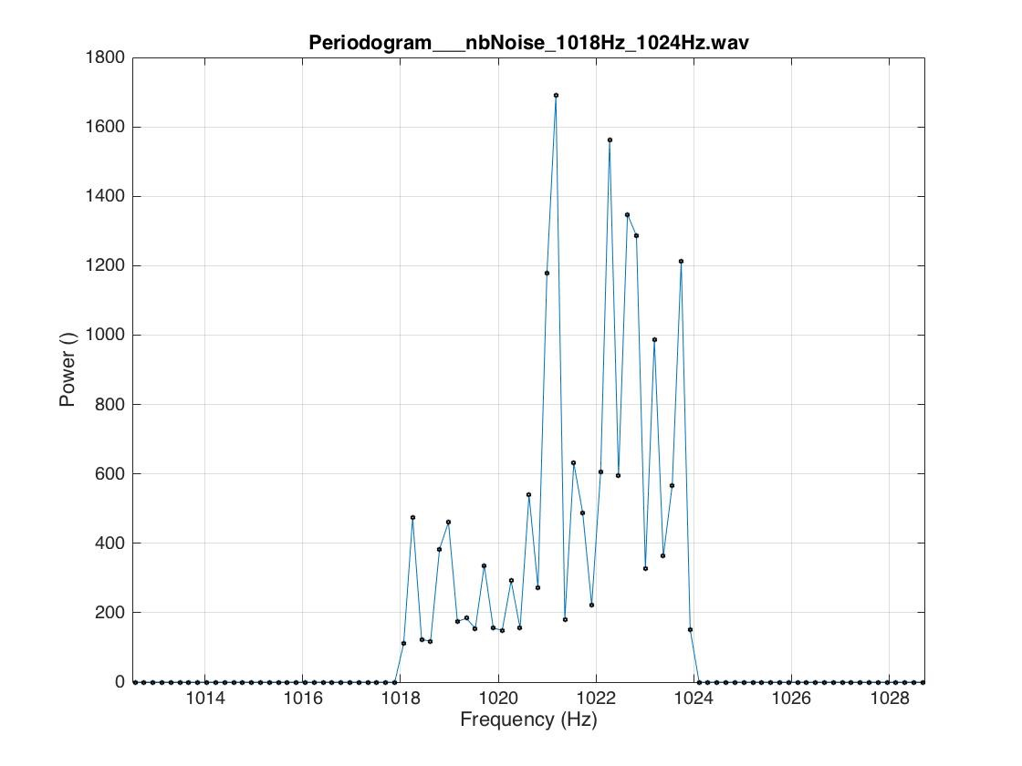
Sum The Obtained Spikes

Slide 36
Super Narrow-band Stochastic Noise

Slide 37
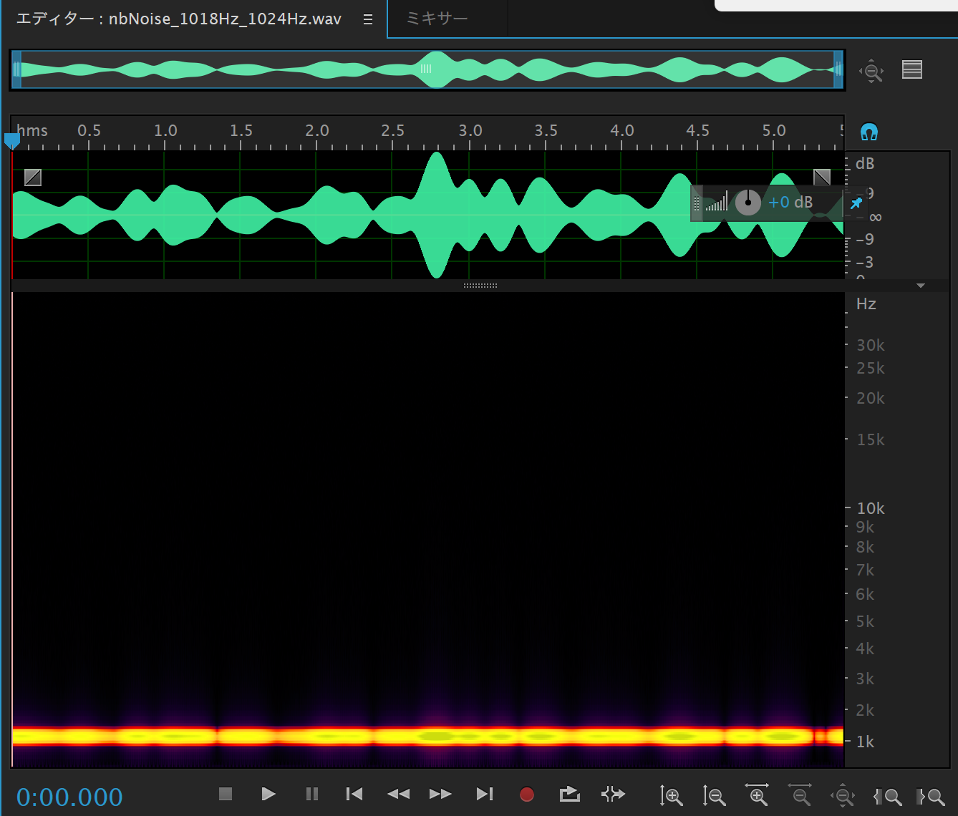
Super Narrow-band Stochastic Noise

Slide 38
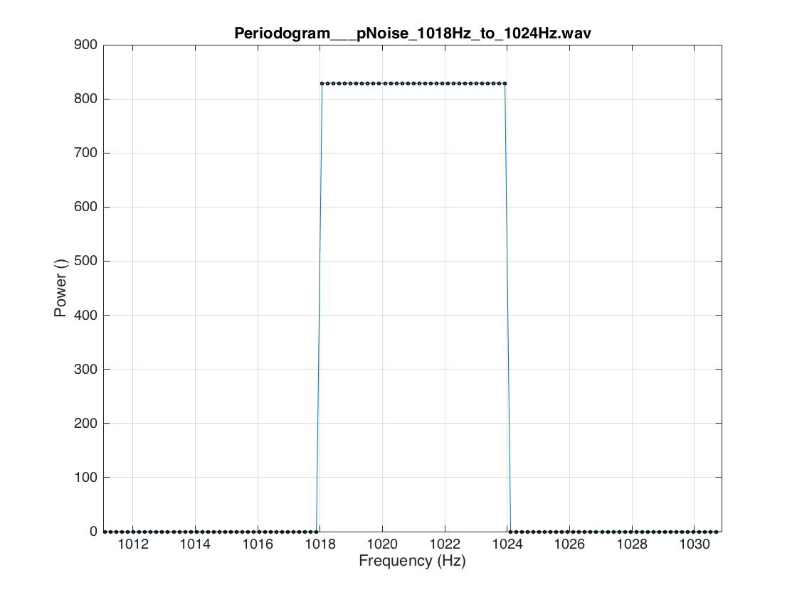
(Application) Super Narrow-band Uniform Noise

Slide 39
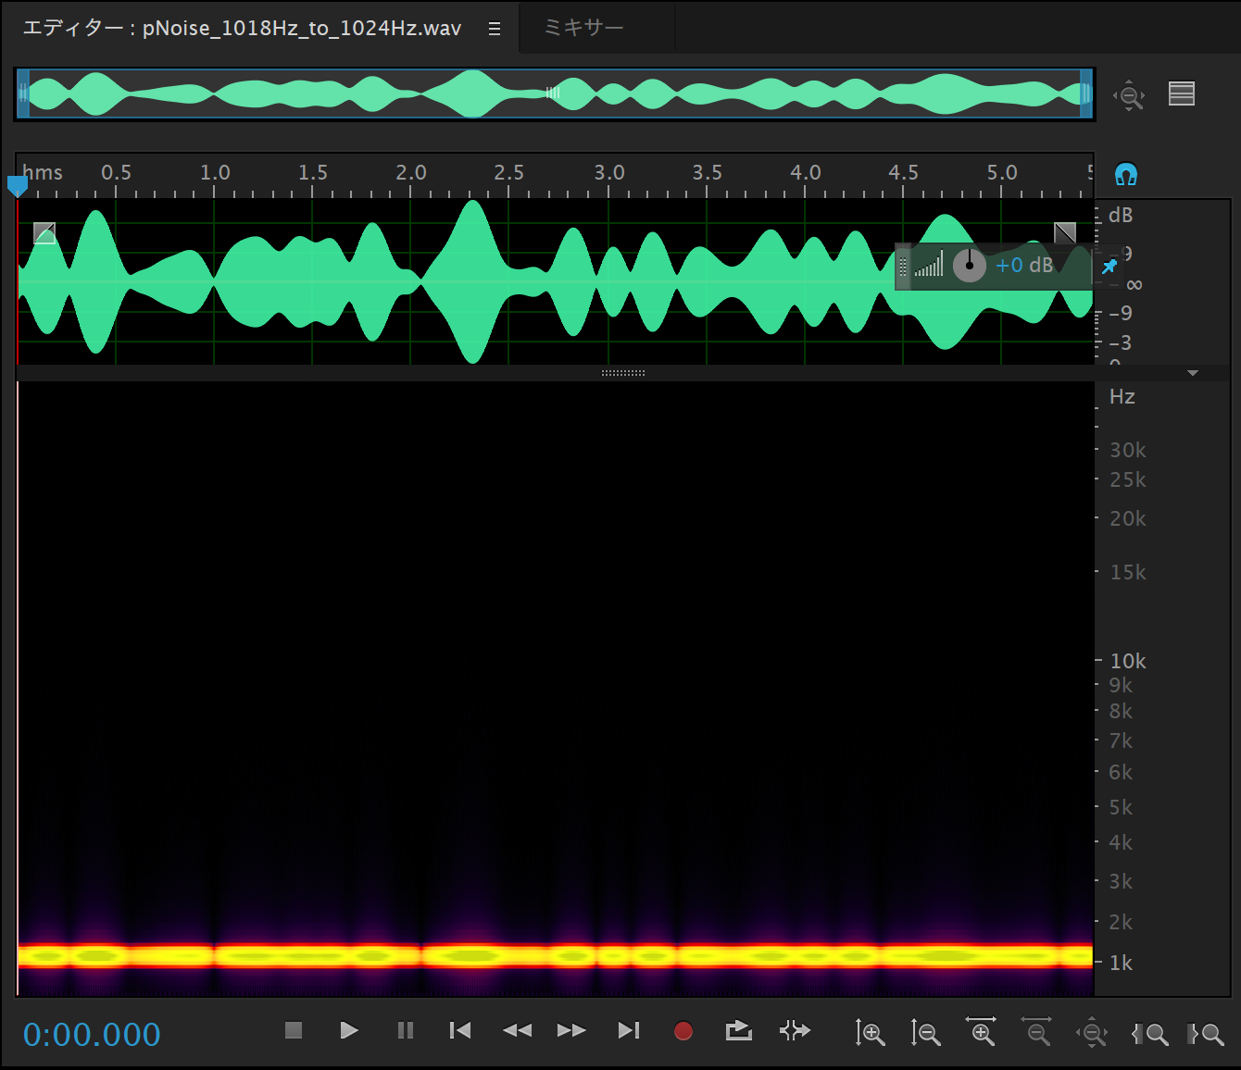
(Application) Super Narrow-band Uniform Noise

Slide 40
(Application) Super Narrow-band Uniform Noise
VERY LONG PERIODICITY

Slide 41
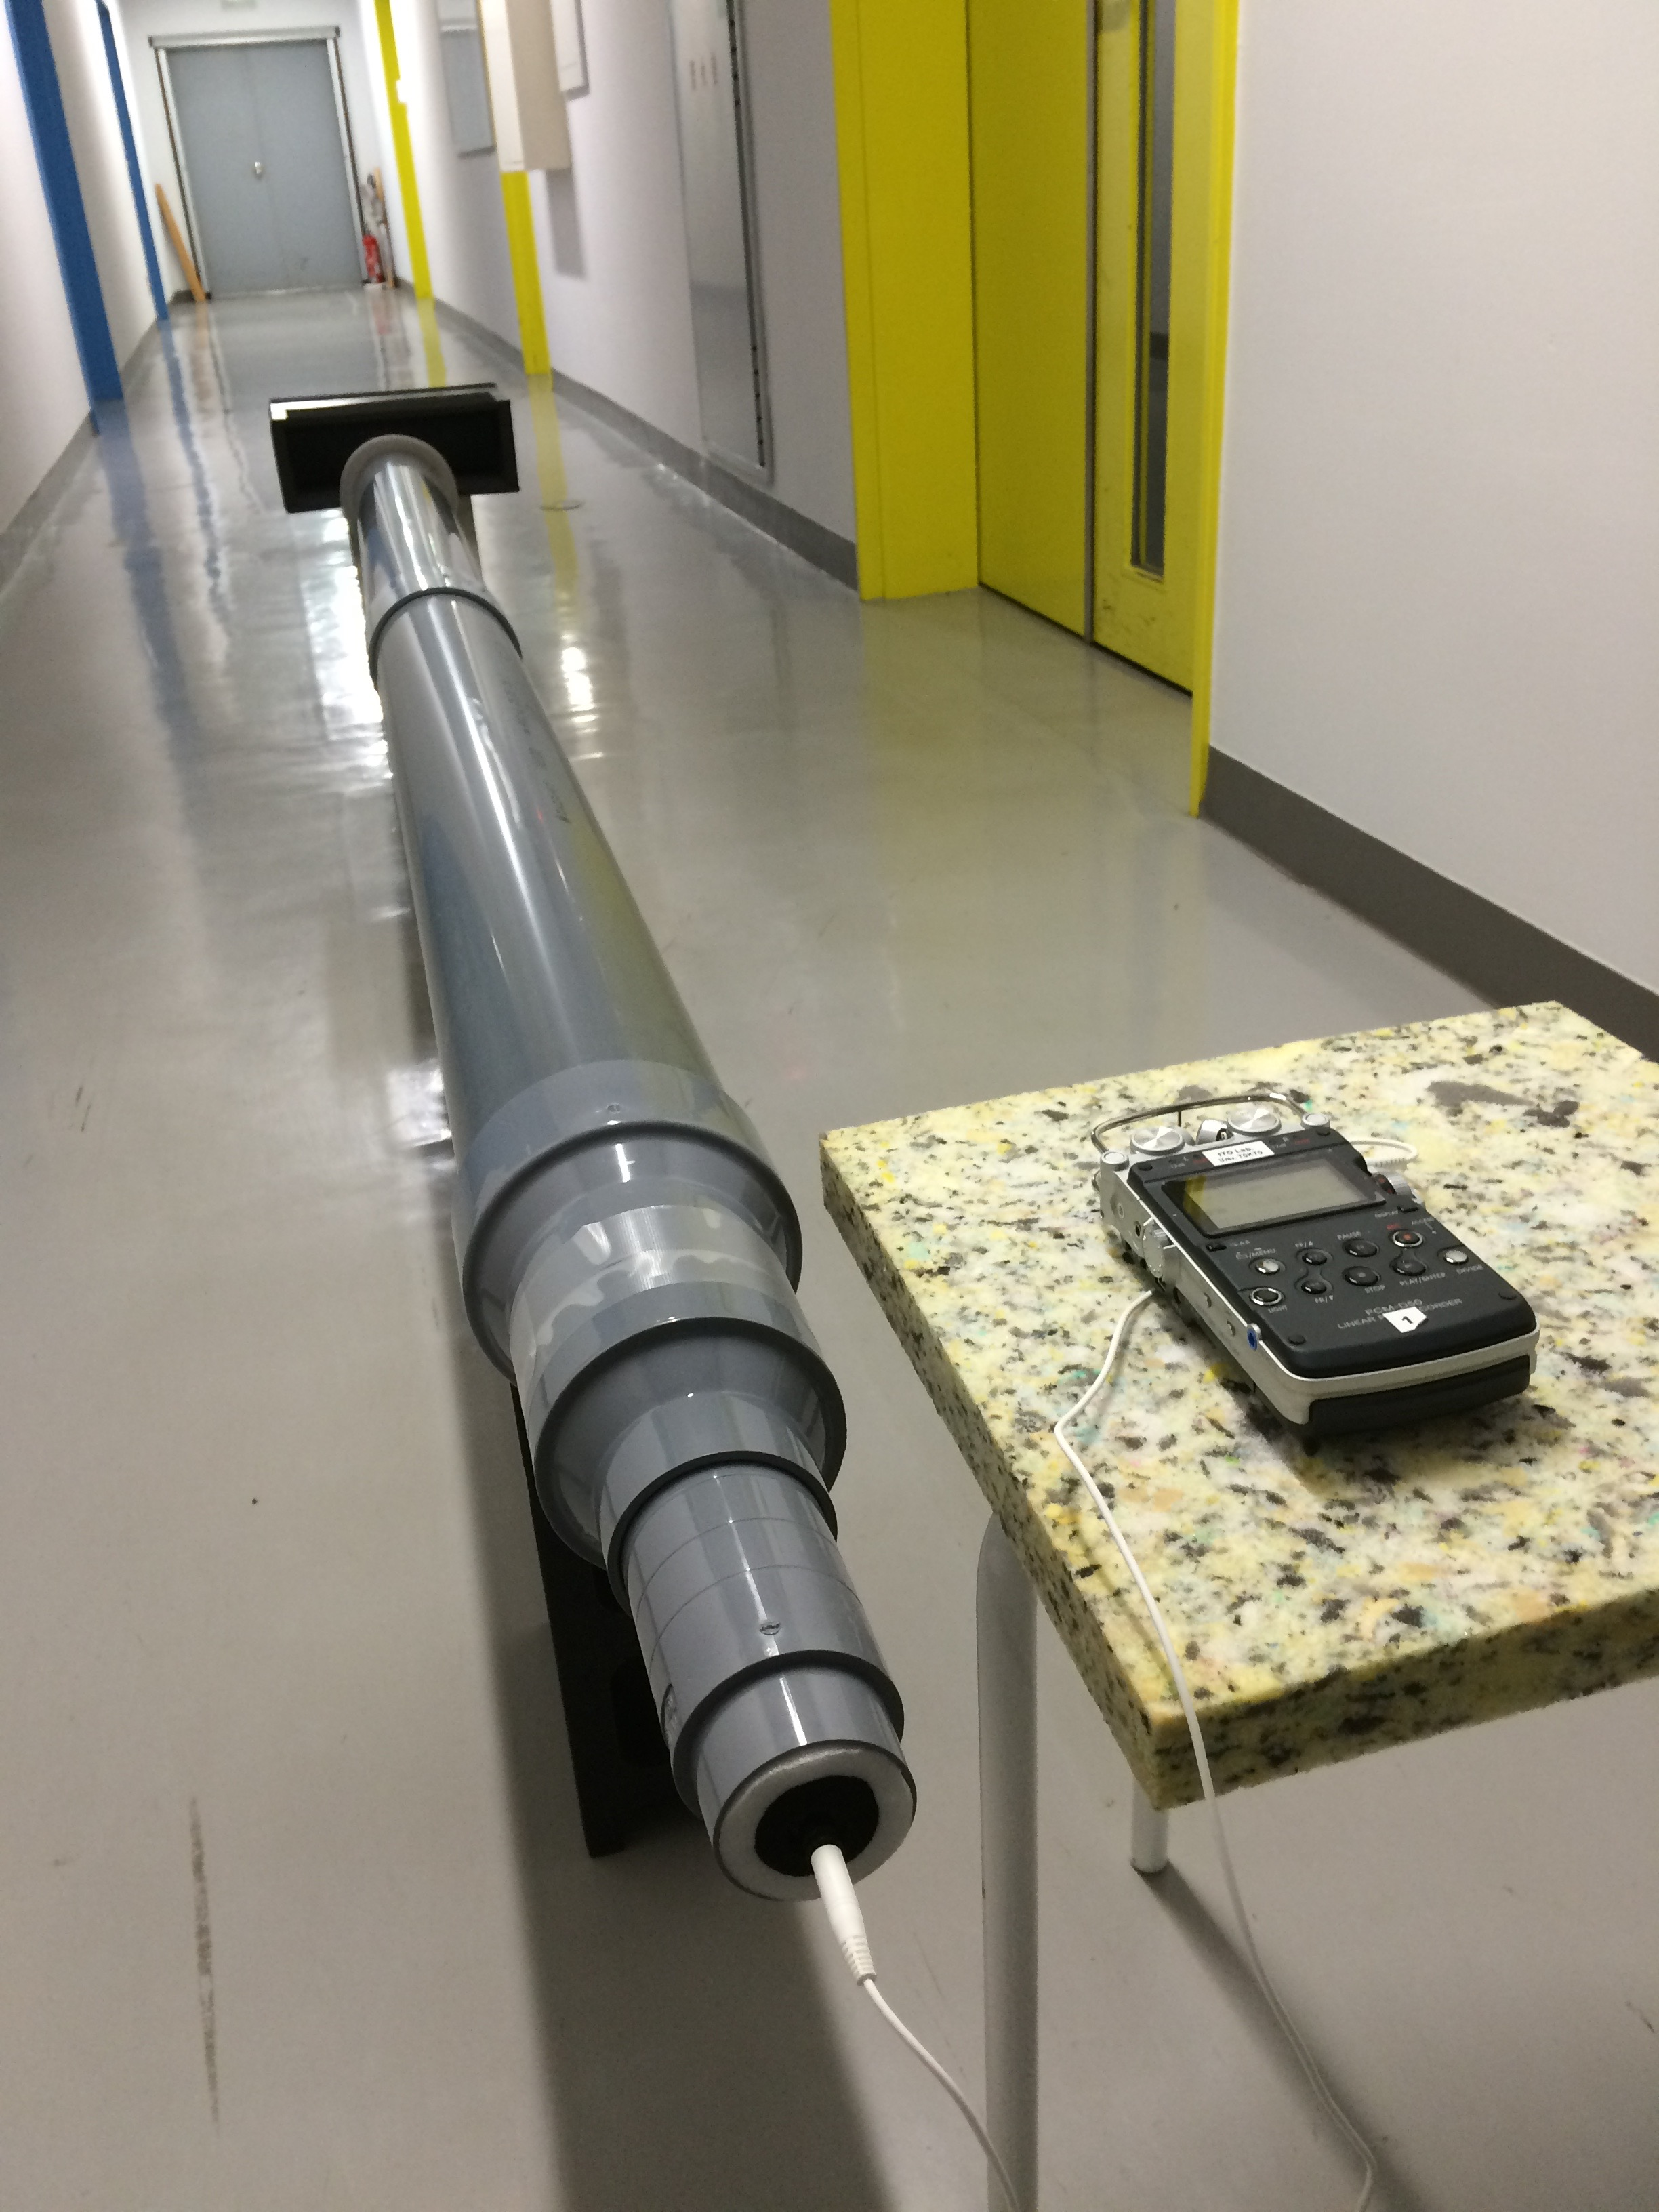
(Experiment) Input Test Noise into Cavity (Physical Env.)

Slide 42
Cavity as Model of Vocal Tract

Slide 43
Comparison between Sine Wave & Stocastic Noise (around 256Hz)
Sine Wave 256Hz
Noise b/w 240 & 256Hz

Slide 44
Structural Timbre
Fluctuate
Dispersed
Sine Wave 256Hz
Blurred
Noise b/w 240 & 256Hz
Interfering
⇒ Brilliant

Slide 45
Structural Timbre
Fluctuate
Dispersed
Sine Wave 256Hz
Formant
Blurred
Noise b/w 240 & 256Hz
Interfering
⇒ Brilliant

Slide 46
Structural Colour
http://blogs.yahoo.co.jp/kozoshoku/46003474.html

Slide 47
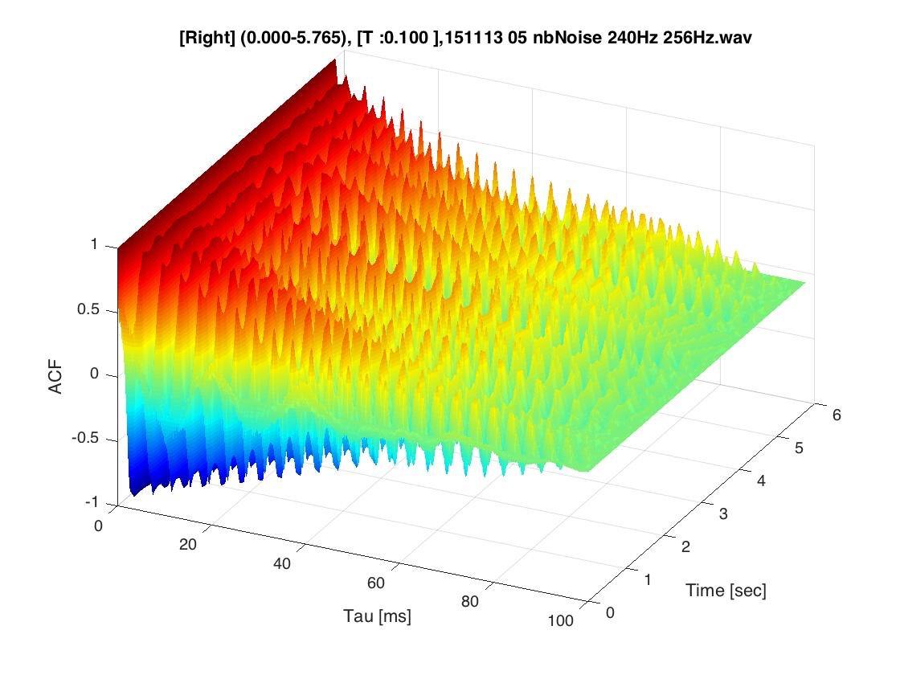
3D Correlogram
of The Recorded Test Noise (b/w 240 & 256Hz)

Slide 48
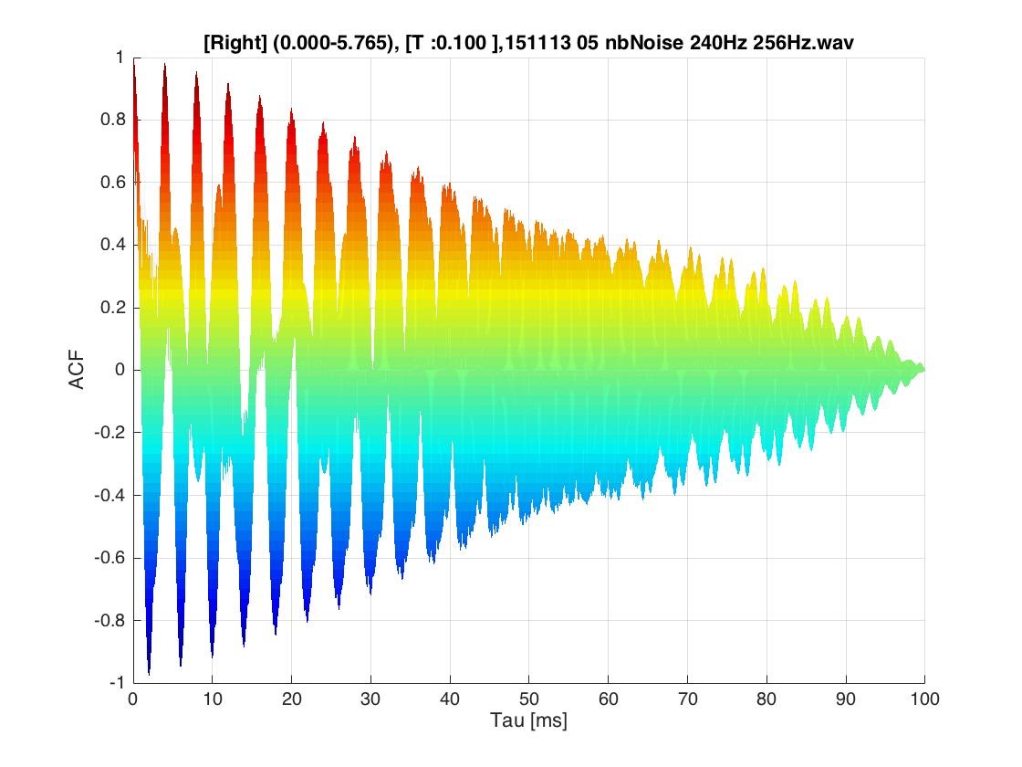
Periodicity around 4ms

Slide 49
Periodicity around 4ms
4ms

Slide 50
4ms

Slide 51
4ms ⇒ 250Hz

Slide 52
4ms ⇒ 250Hz
Sonic Speed ≒ 340 m/s
(15℃, 1013hPa)

Slide 53
4ms ⇒ 250Hz
Sonic Speed ≒ 340 m/s
(15℃, 1013hPa)
340 / 250 ≒ 1.36 m

Slide 54
Uncertainty Principle
4ms ⇒ 250Hz
Sonic Speed ≒ 340 m/s
(15℃, 1013hPa)
340 / 250 ≒ 1.36 m

Slide 55
Uncertainty Principle
4ms ⇒ 250Hz
Sonic Speed ≒ 340 m/s
(15℃, 1013hPa)
340 / 250 ≒ 1.36 m
Unable to determine the space inside 1.36 m

Slide 56
For the other Octave Bands
~ 8192 Hz
~ 512 Hz
~ 4096 Hz
~ 256 Hz
~ 2048 Hz
~ 128 Hz
~ 64 Hz
Research on going

Slide 57
Increasing Threshold Width A Lot More
Now: 64 Hz (1 Hz step)
Future: ? Hz (? Hz step)
We want to find where Brilliancy gone.
Research on going

Slide 58
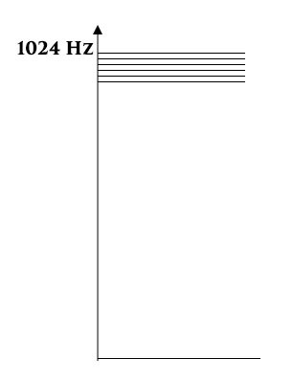
Changing Density by ω0 for FFT
Research on going

Slide 59
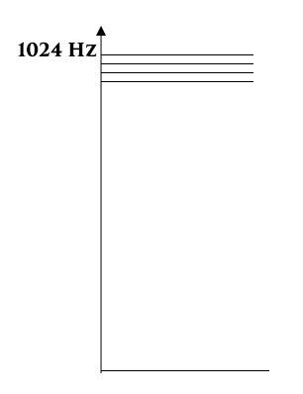
Changing Density by ω0 for FFT
More Sparse
Research on going

Slide 60

Changing Density by ω0 for FFT
More Sparse
More Dense
Research on going

Slide 61
SUMMARY
We defined Proximal Narrow-band Digital Stochastic Noises and discovered “Structural Timbre”
For Different Bandwidths
For Different Cavity (size, length, etc.)
Relationships between voice, instruments and narrow-band noises.

Slide 62
Thank you for your kind attention. Your questions / comments are always welcome.
Division of Composition and Conducting, Interfaculty Initiative in Information Studies, The University of Tokyo
taiso.renpoo@gmail.com (SATO, Koji)
itosec@iii.u-tokyo.ac.jp (ITO, Ken)

